Slide 1
Ranking Web Pages Using Cosine Similarity Measure Group 5
CSCE 5200.005 Information Retrieval and Web Search

Slide 2
Roles of Members
Prem Kamal Osipalli - 11553305
Vishal Anand Potti - 11541764
Aparna Mirapakayala - 11563217
Kalyani Virivinti - 11555487
Ravi Teja Kalturi - 11554532

Slide 3
Outline
The main purpose of this paper is to look at various information retrieval models present and discuss a best approach to rank the documents using document clustering method.

Slide 4
Problem Statement
This paper discusses different models of information retrieval and introduces a method for ranking web pages by utilizing document clustering based on content similarity [3].
The approach described in the paper involves matching the content of documents to a query, and then clustering together the most similar documents for ranking.
For this purpose, document clustering approach has been used. Document clustering method considers the content of the documents. Query will be considered which is used for the purpose of matching the content.
This approach ultimately simplifies the computation process and speeds up the retrieval and ranking of the documents.

Slide 5
Existing Methods
The existing method and proposed method does not have much difference.
But the difference lies while calculating the cosine angle for the documents.
Existing method calculates the cosine angle for all the documents exists. But the proposed method will calculate only for the documents which has all the words of a query.

Slide 6
Comparative analysis of Algorithms
It depends on various factors such as accuracy, efficiency, scalability and ease of implementation [1].
The accuracy of the algorithm used depends on the data and on which bases we are grouping the documents that are used for the analysis.
The algorithm seems to be efficient as we are using the documents to find their cosine similarities depending on the size of the dataset and terms present in each document.
It is scalable and able to handle large datasets and provide the cosine similarities if each document contains more term than we expect.
Algorithm is easy to implement when compared to other techniques for finding cosine similarity and ti-idf.
[1] Manning, C. D., Raghavan, P., & Schütze, H. (2008). Introduction to information retrieval.
Cambridge University Press (01 April 2008).
https://nlp.stanford.edu/IR-book/information-retrieval-book.html

Slide 7
Implementation
In today’s world, there has been a huge information present in the web. So, it is hard to get the relevant information because of the huge data present in web.
Information retrieval models and ranking algorithms is important in finding the exact information required.
Algorithms usually works in a way to find information based on the content of web pages.
We have a different ranking algorithms which can be used for getting the relevant information [2].
This paper gave an overview about what type of models will be used in retrieval and similarity measures. Similarity measure's main purpose is to find relevancy among the web pages. Finally, Ranking will be performed for the web pages.
[2] Shadab Irfan, Subhajit Ghosh, 2019, “A Review on Different Ranking Algorithms” (01 July 2019). https://ieeexplore.ieee.org/document/8748837

Slide 8
Method Explanation
Information Retrieval Process and Models [4]:
The focus is to find the appropriate information user has requested.
Required information entered by user will be sent in the form of query. Query formulation will help in forming the query. Document modeling will be used for document representation.
Then query and document representation will be sent for modeling to retrieve the document required. In order to increase the quality while retrieving the documents, clustering will be used. It helps in arranging the data in structured format.
Clustering will be performed in two stages which are document preprocessing and dividing them into clusters .

Slide 9
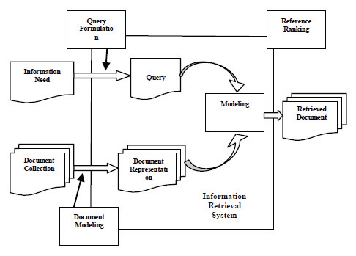
Method Explanation

Slide 10
Method Explanation
Document Clustering and Similarity Measure
Clustering plays an important role when we have a large amount of data. Clustering helps in improving the retrieval process by retrieving only necessary data. It organizes same type of web pages into groups.
Clustering helps the users in finding the pattern according to their search needs thereby improving the retrieval process. Another important aspect in clustering is, it will reduce the retrieval time.
Document similarity will be calculated which is specified by cosine between two vectors [2]. We will calculate the term frequency that is denoted by ‘tf’ and inverse document frequency which is denoted by ‘idf’. These terms plays the key role in finding the similarity.
[2] Shadab Irfan, Subhajit Ghosh, 2019, “A Review on Different Ranking Algorithms” (01 July 2019). https://ieeexplore.ieee.org/document/8748837

Slide 11

Method Explanation
Document Clustering and Similarity Measure [5]
Term Frequency is specific to individual term and each term will be assigned a weight. This weight will be assigned based on how many times each term occurred in a particular document. We can consider it as tf t,d.
Inverse document will be calculated based on all the documents. It means number of times term occurred document we consider to the total documents we have. It will be calculated as

Slide 12
Method Explanation
Document Clustering and Similarity Measure
Composite weight will also be calculated as product of term frequency and inverse document frequency.
Cosine similarity will be calculated for documents d1,d2 as
Finally, cosine similarity between documents and query ‘q’ will be calculated as well.

Slide 13
Method Explanation
Proposed Approach
This paper proposed an approach which will follow the below steps:
Search engine accepts user query.
Calculates tf-idf score based on query and documents.
Cluster the documents.
Calculate similarity measure using cosine angle to rank the documents.

Slide 14
Method Explanation
Proposed Approach
Let’s consider an example to understand the proposed approach.
Let’s say that query is of 4 terms. E.g., “Information Retrieval Evolutionary Computation”.
We have a seven web pages contains the information of the mentioned query.
As an initial step, search engine accepts the query entered by user and found the seven web pages.
Term frequency and inverse document frequency will be calculated based on the query mentioned.
Initially tf-idf score for a term will be calculated and tf-idf score of a document with respect to query will also be stored in a table.
Cosine angle will be calculated for each document with respect to query.

Slide 15
Method Explanation
Proposed Approach
Now the approach this paper has been proposed will come to picture.
Instead of calculating cosine angle for the documents, it is better to calculate for only the documents which has all the words of a query.
Let’s say that documents A,B,D contains all words of a query.
Clustering will be performed on all these 3 documents and results will be stores.
Once clustering have been completed, cosine angle for all these 3 documents will be calculated.
Then based on the cosine similarity, Ranking will be assigned.
Based on the ranks, web pages will be displayed initially to user.

Slide 16
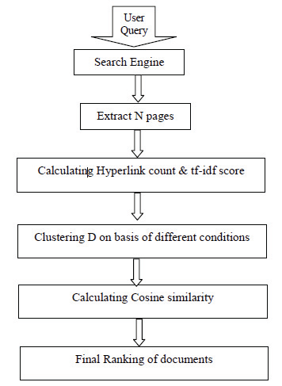
Method Explanation

Slide 17
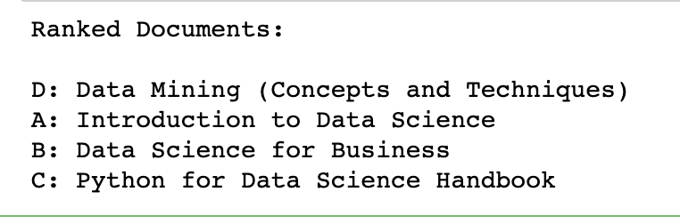
Output

Slide 18
Result Analysis
From the obtained output, we can observe that document ranks has been showed clearly along with the document text as well.
In order to obtain this result, different documents has been considered with respect to a query which will be used in determining the document ranks.
At last clustering has been performed to determine the ranks.

Slide 19
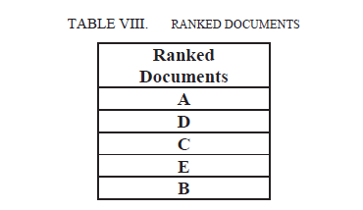
Obtained results vs described results
Results obtained from the code execution was shown in previous slide. Ranks of the documents along with document text has been shown [3].
Document clustering method was applied in order to show the results obtained. Document clustering was performed with respect to the query specified.
Results obtained in paper also performed the document clustering method and showed the ranks of the documents.

Slide 20
Advantages and Limitations
Advantages:
This method is easy to implement as cosine similarity is a simple mathematical calculation.
This method is very effective and produces accurate results.
This method can be effectively used for large datasets.
Disadvantages:
Pre-processing is must for web pages, and this is time consuming.
This method is only applicable for text data but not for images or videos.

Slide 21
Applications
It has a wide range of applications. Let’s look at some of the applications.
Recommendation systems: This method can be used to recommends movies, products based on the user's choice and experience.
Content based Filtering: It can be used to filter the items and provides recommendations to the users based on the articles they read before.
Text classification: This method can be used to divide documents into different categories.

Slide 22
Conclusion
In summary, the author asserts that when it comes to information retrieval and ranking algorithms, the content being considered is crucial in determining cosine similarity for the selected documents, depending on the algorithm utilized.
Implementing document clustering with a similarity measure can effectively retrieve the desired information based on a query and simplify the computation process overall.
The process of retrieving information can be time-consuming, but it can be made simpler and more cost-effective by reducing the complexity of the computation involved. By doing so, the required information can be found more easily and quickly, thereby saving time and cost.

Slide 23
Citations
[3] Shadab Irfan, Subhajit Ghosh, 2019, “A Review on Different Ranking Algorithms” (01 July 2019).
DOI: https://ieeexplore.ieee.org/document/8748837
[4] Shadab Irfan, 2019, Ranking Web Pages Using Cosine Similarity Measure (27 Sept 2019).
DOI: https://ieeexplore.ieee.org/document/8940454
[5] Subhajit Ghosh , 2019, Ranking Web Pages Using Cosine Similarity Measure (27 Sept 2019).
DOI: https://ieeexplore.ieee.org/document/8940454

